Slide 1

EMBEDDED SYSTEM DESIGN PROJECT ESE-4009 PCB Designing
Submitted by: HARMANDEEP SINGH (C0751299)
(Group 2)

Slide 2
List of Content
Project Introduction
Task Introduction
Hardware Discussion
Software Discussion
Results
Conclusion
References

Slide 3
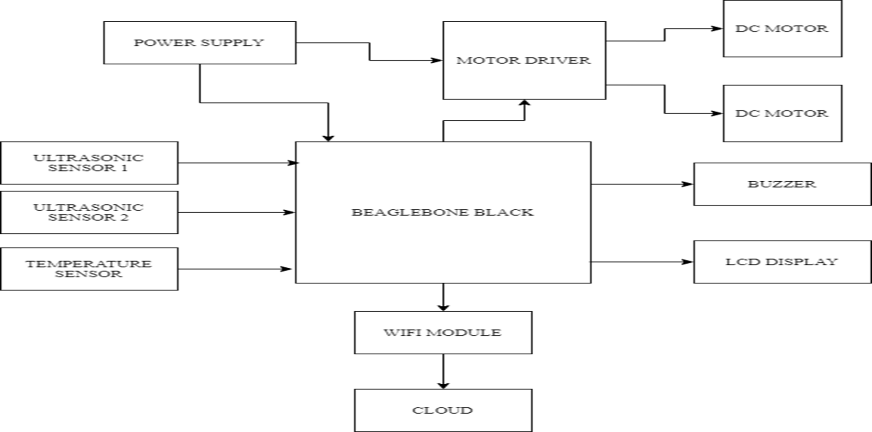
IoT based Visitor Counter using Beaglebone Black

Slide 4
Task Introduction
In the previous meetings we demonstrated the interfacings of all the sensors and modules used in this project.
This Task is about generating PCB design for our project.
We will design and generate all the required files for PCB design.
This task is related to the Schematic capture task which was already discussed previously so we will be using the Schematic prepared in that task to accomplish this task.
In the following slides we shall discuss the composition of a printed circuit board, cover some terminology, a look at methods of basic assembly and discuss briefly the design process behind creating a new PCB.

Slide 5
What is PCB Design
One of the key concept in electronics is the Printed Circuit Board.
Printed Circuit Boards (PCB) design brings your electronic circuits to life in the physical form.
It mechanically supports and electrically connects electrical or electronic components using conductive tracks, pads and other features etched from one or more sheet layers of copper laminated onto and between sheet layers of a non conductive substrate.
It is a board that has lines and pads that connect various points together.

Slide 6
What is PCB Design
A PCB allows power and signals to be routed between physical devices.
Solder is the metal that makes the electrical connections between the surface of the PCB and the electronic components.
Being metal, solder also serves as a strong mechanical adhesive.
The benefit of designing a circuit board for printing is that it is cleaner and more reliable than a circuit built on a breadboard.
We can find PCB today in almost any consumer electronics like Telephone, TV Remote, Alarm clocks, cell phones and many more.

Slide 7
Terminology
Annular ring - the ring of copper around a plated through hole in a PCB.
DRC - design rule check. A software check of your design to make sure the design does not contain errors such as traces that incorrectly touch, traces too skinny, or drill holes that are too small.
Pad - a portion of exposed metal on the surface of a board to which a component is soldered.
Plane - a continuous block of copper on a circuit board, define by borders rather than by a path.
Package – a package is the 3-Dimensional shape of the component, and indicates how it mount to the circuit board.
Footprint – a footprint is the 2-Dimensional layout of the package on the top of the surface of board. It consists of a silkscreen layout, name label, plated through hole or pads, and any other necessary layout information. This is one of the important term and is very important when making a PCB

Slide 8
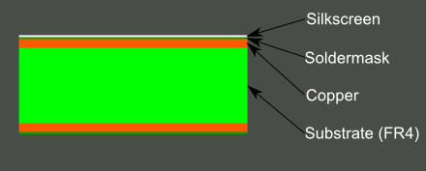
Basic PCB Composition
A PCB is composed of alternating layers of different materials which are laminated together with heat and adhesive such that the result is a single object.
Most of the PCB’s are four layers in which two inner layers are sandwiched between top and the bottom layer.
These layers are :
The base material or Substrate
Copper
Soldermask
Silkscreen

Slide 9
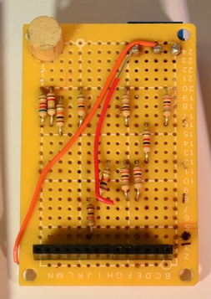
Substrate
The base material, or substrate, is usually fiberglass.
The most common designator for this fiberglass is "FR4".
FR4 is a NEMA grade designation for glass-reinforced epoxy laminate material.
This solid core gives the PCB its rigidity and thickness.
Cheaper PCBs will be made with other materials such as epoxies or phenolics which lack the durability of FR4 but are much less expensive.

Slide 10
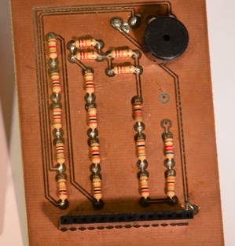
Copper
The next layer is a thin copper foil, which is laminated to the board with heat and adhesive.
On common, double sided PCBs, copper is applied to both sides of the substrate.
In lower cost electronic gadgets the PCB may have copper on only one side.
The image shows PCB with copper exposed with no soldermask or silkscreen.

Slide 11
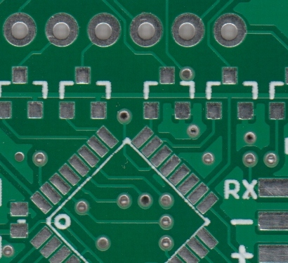
Soldermask
The layer on top of the copper foil is called the soldermask layer.
This layer gives the PCB its green or, red color. It is overlaid onto the copper layer to insulate the copper traces from accidental contact with other metal, solder, or conductive bits.
This layer helps the user to solder to the correct places and prevent solder jumpers.
Soldermask is most commonly green in color but other colors may also be used.

Slide 12
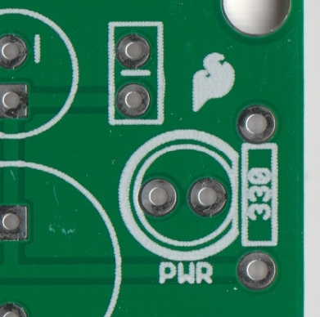
Silkscreen
The white silkscreen layer is applied on top of the soldermask layer.
The silkscreen adds letters, numbers, and symbols to the PCB that allow for easier assembly and indicators for humans to better understand the board.
We often use silkscreen labels to indicate what the function of each pin or LED.
Silkscreen is most commonly white but any ink color can be used.

Slide 13
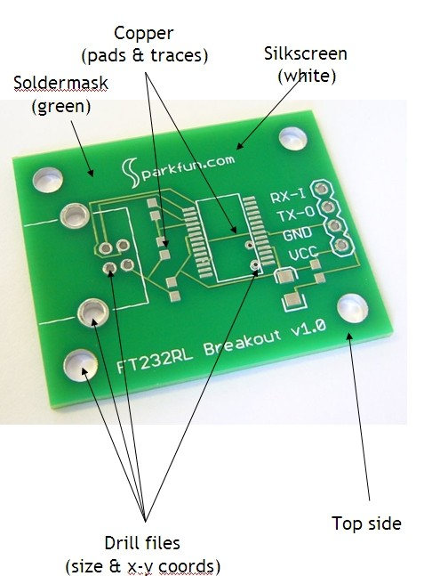
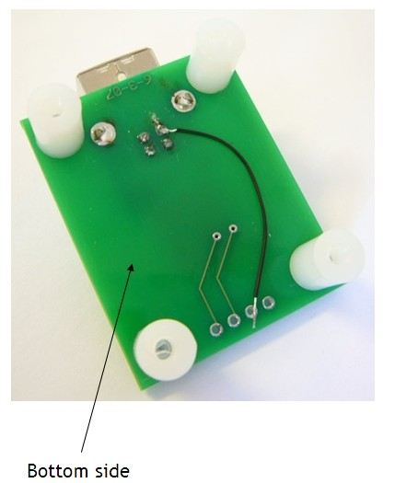
PCB Design summary

Slide 14
Classification of PCB
According to circuit layer classification we have following types of PCB:
Single Sided PCB
Double Sided PCB
Multi layer PCB

Slide 15

Single Sided PCB
It’s the most basic type of PCB which contains only one layer of base material (Substrate).
They are easy to manufacture in which circuits and components are soldered on one side of the substrate.
Single sided PCBs are an ideal choice for the beginners and are mostly used in simple electronics which don't involve complex circuitry.

Slide 16
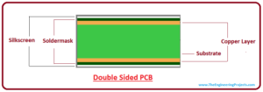
Double Sided PCB
It is similar to single sided PCB with one exception, it contain copper material on the both side of the substrate material.
Double sided PCBs feature moderate level of complexity and mostly used in wide range of applications including automotive dashboard, LED lighting, vending machines, amplifiers, HVAC system, instrumentation and many more.

Slide 17
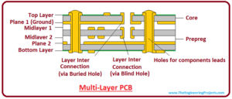
Multi Layer PCB
It is more complex than double sided PCB and come with a combination of single sided and double sided boards.
There are more layers available on these boards than double sided boards.
Multilayers on the boards allow the professionals to make complex and thick designs which help in accomplishing more complex electrical tasks.
Multilayer PCBs are widely used in number of applications including Satellite system, GPS technology, Data storage, File servers and Weather analysis systems.

Slide 18
PCB Designing in EasyEda
EasyEDA is a web-based EDA tool suite that enables hardware engineers to design, share and discuss schematics, simulations and printed circuit boards.
Other features include the creation of a Bill of Materials, Gerber and pick and place files and documentary outputs in PDF, PNG and SVG formats.
EasyEDA allows the creation and editing of schematic diagrams, and the creation and editing of printed circuit board layouts and, optionally, the manufacture of printed circuit boards.

Slide 19
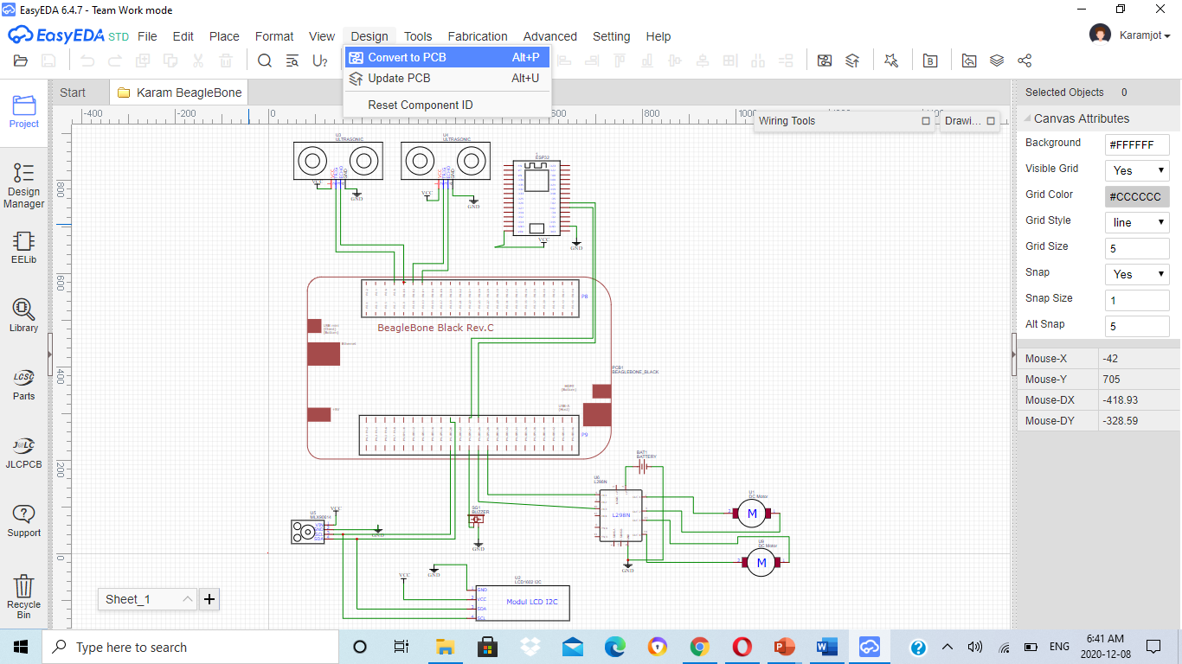
PCB Design Steps
The first step is to create a schematic, since we have already covered this task before so we will use the same schematic.
After preparing the schematic then click on convert to PCB option.

Slide 20
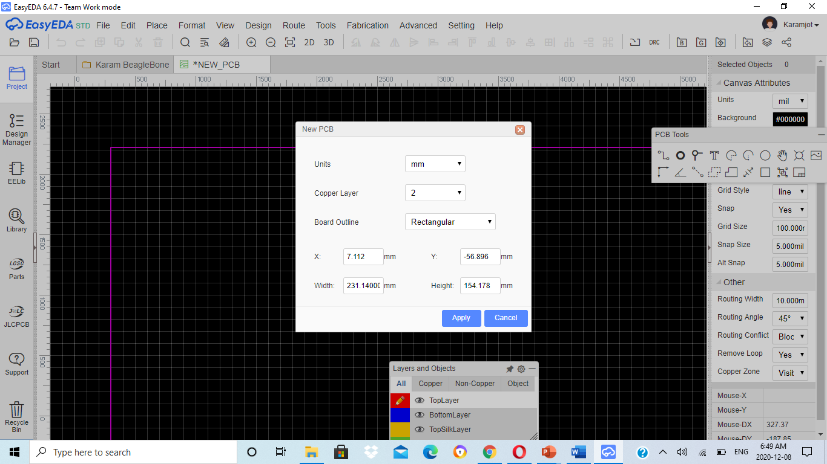
PCB Design Steps

Slide 21
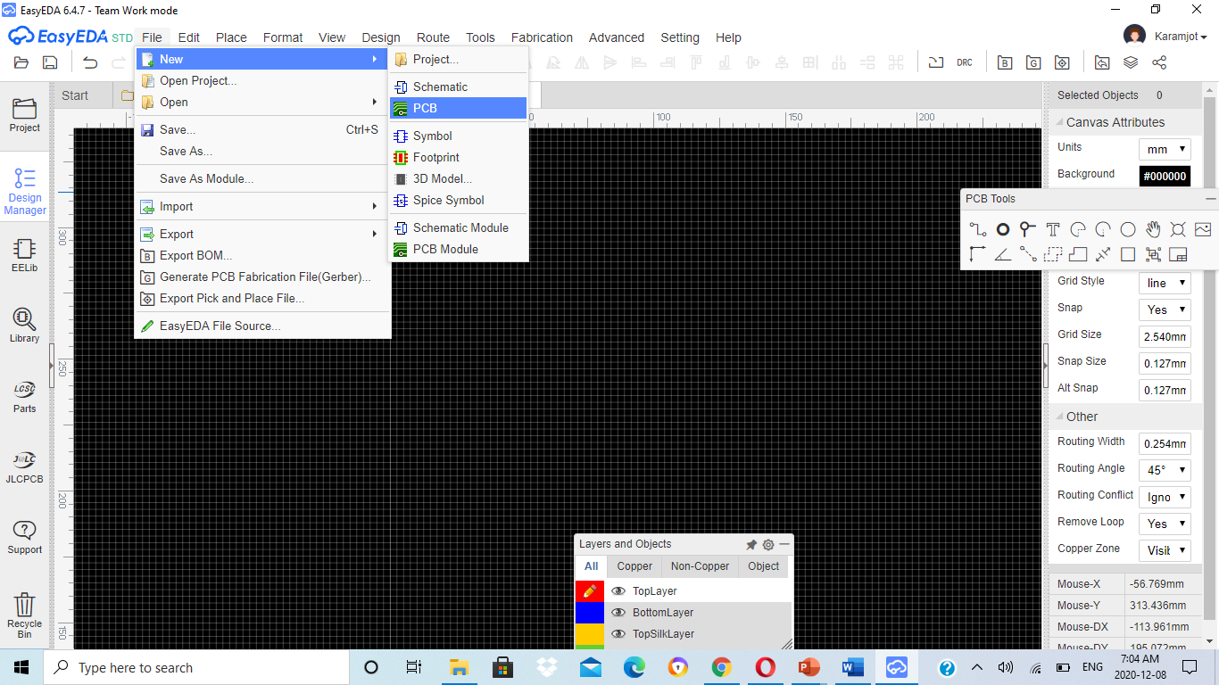
PCB Design Steps
An alternative way to create a PCB in case if we don’t want to use the schematic is to select the components directly the same way we did it for schematic capture.
While selection make sure that the component has some footprint or PCB layout available else we won’t be able to establish the connection.
Once we have all the components ready we can start the connection using the connect pad to pad(o) using PCB tools.

Slide 22
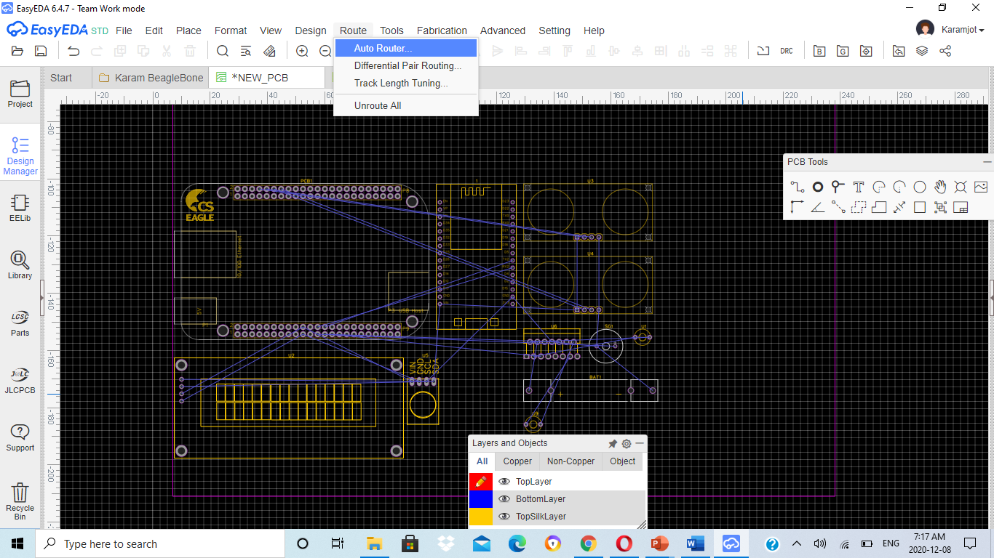
Routing
Once the connection is done the next step is routing so we can use the autoroute option to layout the trace or we can do it manually using the PCB tools.
If the circuit is complex and large then auto routing is preferred else you can go with manual routing in case of simple circuits.
For autorouting select the Auto Route option under the Route menu.

Slide 23
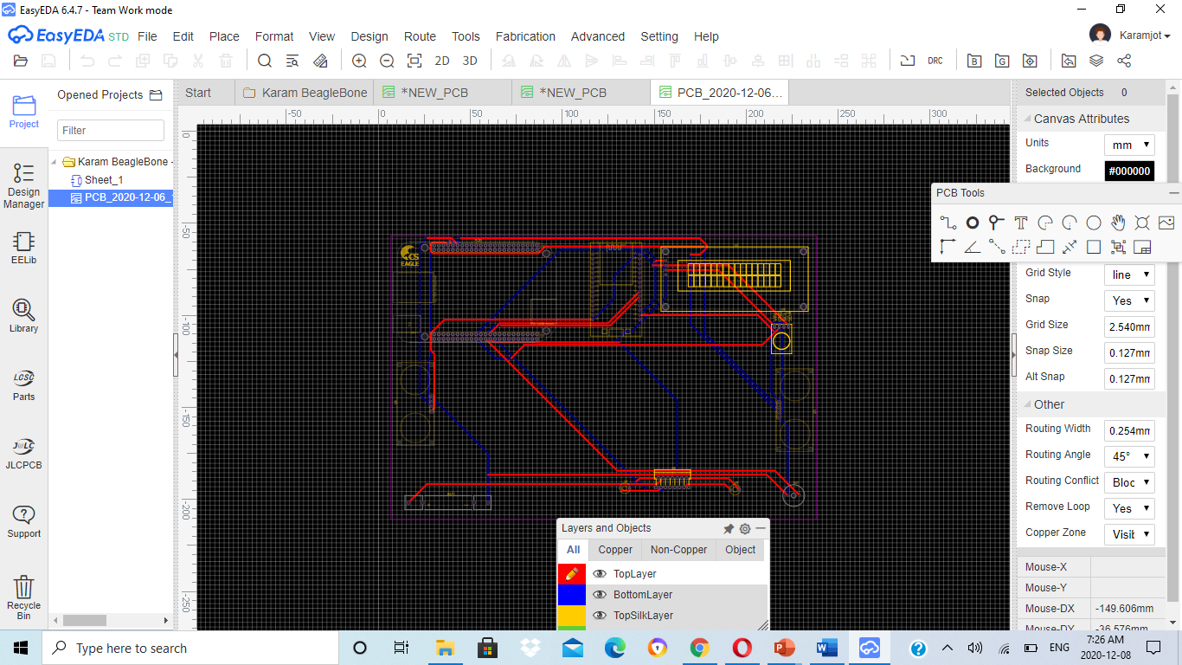
PCB Design Layout

Slide 24
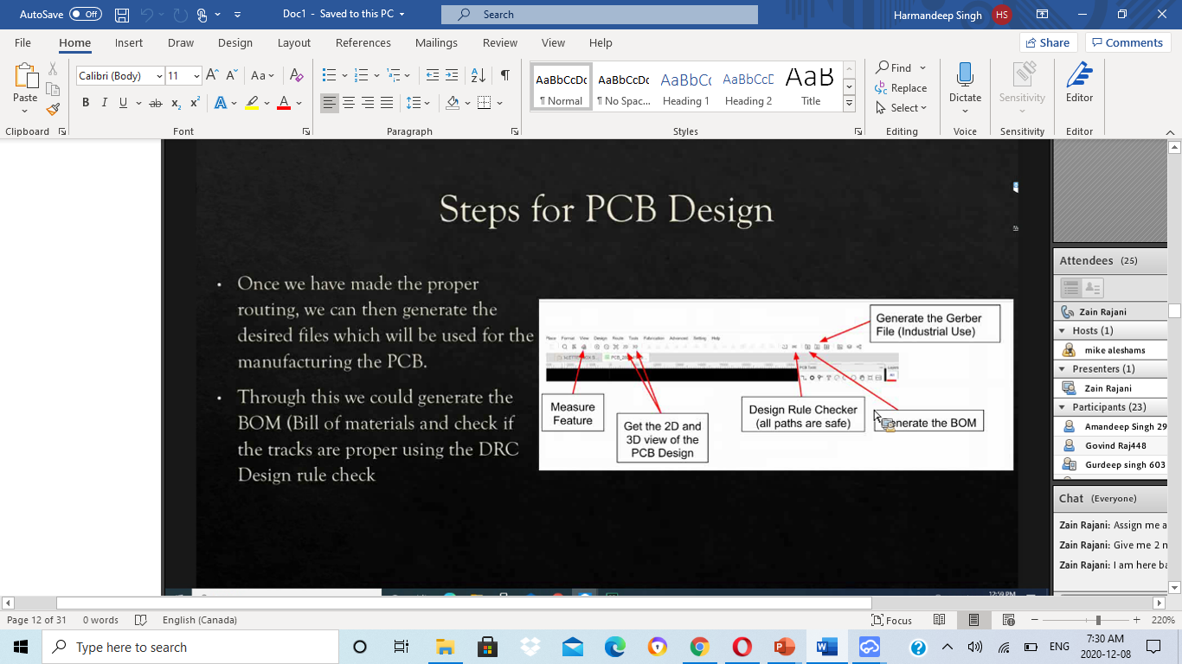
PCB Design Steps

Slide 25
Conclusion
Pcb Designing was discussed
Successful PCB layout was made
Gerber files were generated and viewed successfully

Slide 26
References
https://docs.easyeda.com/en/PCB/PCB-Tools/index.html
https://learn.sparkfun.com/tutorials/pcb-basics/all
https://www.electronics-notes.com/articles/analogue_circuits/pcb-design/how-to-design-pcb-board-basics.php
https://www.theengineeringprojects.com/2018/03/different-types-of-pcb-printed-circuit-board.html
https://www.instructables.com/PCB-Concepts-and-Materials/#:~:text=A%20PCB%20consists%20of%20a,need%20to%20concern%20ourselves%20with.
https://www.pcbway.com/blog/Engineering_Technical/Printed_Circuit_Board_Design_Flow.html

Slide 27

THANK YOU

